Slide 1
MATLAB foundation –回顾与补充
matlab fundation

Slide 2
Automating Commands with Scripts
matlab fundation

Slide 3
Matlab的两种源程序文件格式
M-脚本文件（M-script）
  包含一组由matlab语言所支持的语句。
  执行：在提示符下输入该文件名
  M-script 适合于小规模运算
M-函数格式
  每个M-函数文件包括一个主函数
  函数的调用通过M-函数文件名，再加参数调用。
  M-函数是 MATLAB 编程的主流方法
matlab fundation

Slide 4
Script Files
Scripts do not have inputs and outputs. MATLAB executes the commands as a batch, in order.
Scripts are used to automate useful blocks of commands.
Text following a percent sign(%) is a comment.
The first continuous block of comments in an file is reserved for help information. Help is displayed when you use the syntax
>> help filename
The first comment line in the help is called the H1 line. It should contain the filename and a brief description of the purpose of the file.
matlab fundation

Slide 5
Logic and Flow Control
matlab fundation

Slide 6
Logical Operations and Variables
logical variables have only two possible values: true and false, 1 and 0
>> x = pi > 3 %x=1,which is a logical variable
To test for equality, use a double equal sign, which is the logical equality operator in MATLAB:
>> x = pi == 3
>> x = (pi > 3) & (pi < 4)
all the relational and logical operators
>> help ops
matlab fundation

Slide 7
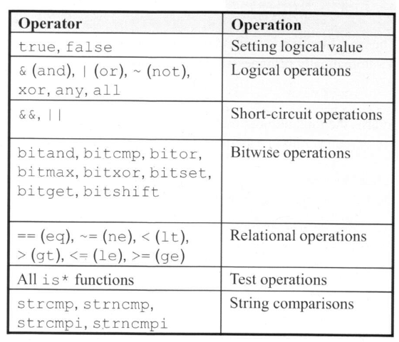
Logical Functions
matlab fundation

Slide 8
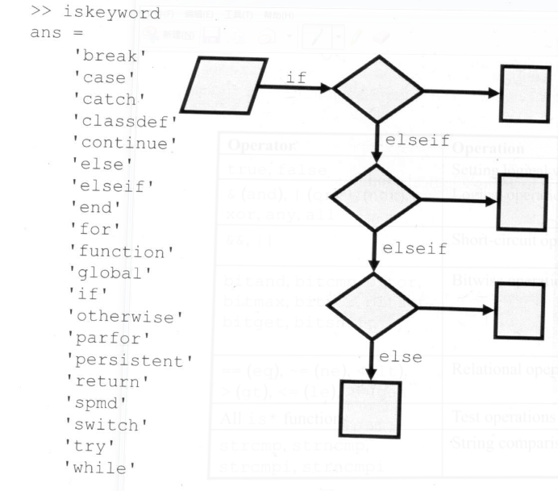
Programming Keywords
matlab fundation

Slide 9
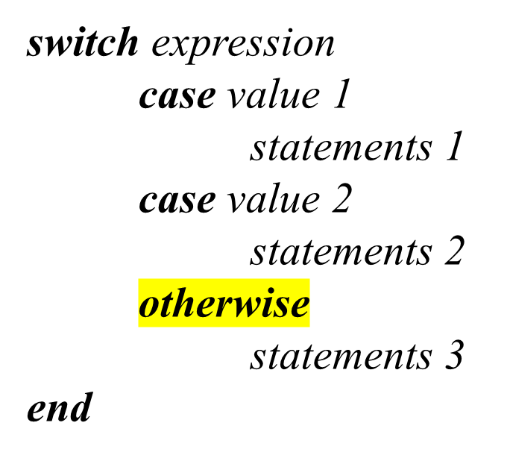
Flow Control
Flow control constructions allows you to introduce conditional branching into your programs.
if (logical test 1)
statements 1
elseif (logical test 2)
statements 2
else
statements 3
end
matlab fundation

Slide 10
example
Example for ‘if’
  ‘ifelse.m’
Example for ‘switch’
  ‘switchcase.m’
matlab fundation

Slide 11
For-Loops
for index = first:increment:last
statements
end
Example:
v= [1,2,3,5,8,13];
for k = v
statements
end
Another example ‘forloop.m’
matlab fundation

Slide 12
While-Loops
while condition
statements
end
Another example ‘whileloop.m’
matlab fundation

Slide 13
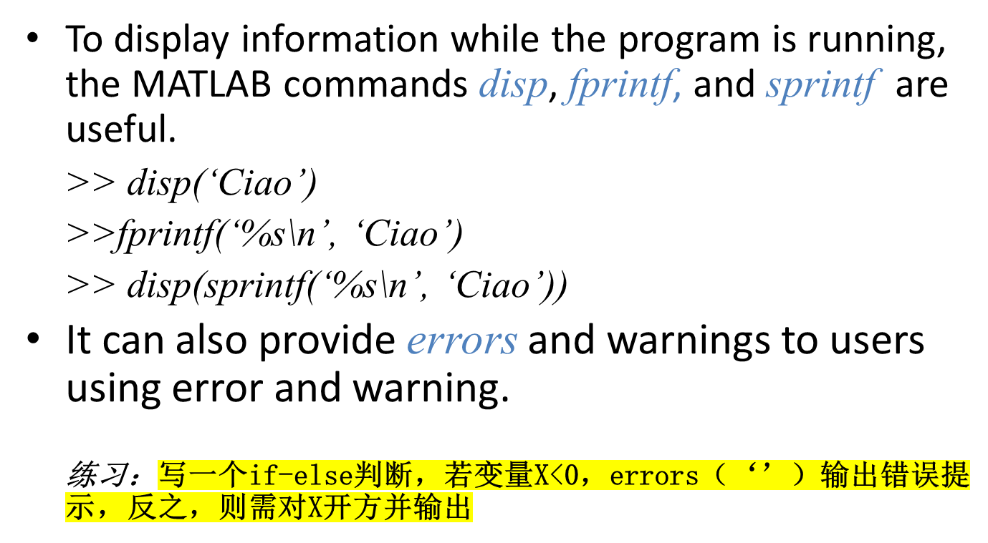
Providing Output
matlab fundation

Slide 14
Providing Output
It can also provide errors and warnings to users using error and warning.
if (x<0)
error(‘Negative square root?! I quit!’)
else
y=sqrt(x);
disp(y);
end
matlab fundation

Slide 15
Obtaining User Input
The input command pauses execution and displays a message (or prompt) to the user.
uage = input(‘Please enter your age: ‘);
When expecting text input, add ‘s’ option to the input function.
uname = input(‘Please enter your name: ‘, ‘s’);
matlab fundation

Slide 16
函数编写与调试
matlab fundation

Slide 17
Matlab的两种源程序文件格式
M-脚本文件（M-script）
  包含一组由matlab语言所支持的语句。
  执行：在提示符下输入该文件名
  M-script 适合于小规模运算
M-函数格式
  每个M-函数文件包括一个主函数
  函数的调用通过M-函数文件名，再加参数调用。
  M-函数是 MATLAB 编程的主流方法
matlab fundation

Slide 18
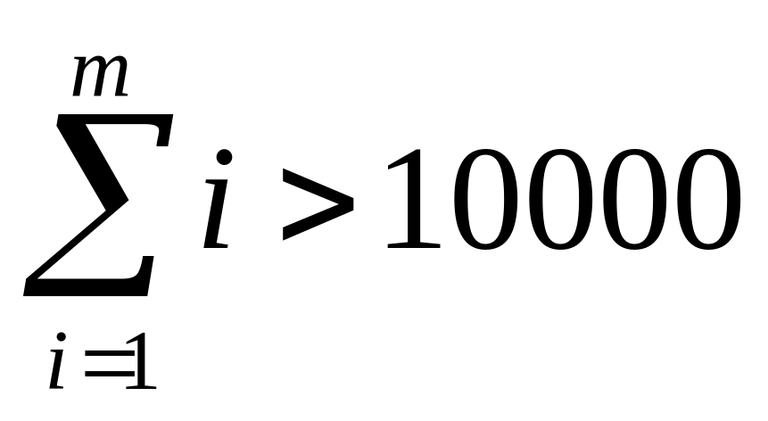
【例】求满足下列求和公式的最小的m值；
练习：用脚本语言实现该求和公式
matlab fundation

Slide 19
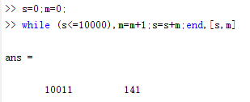
【例】求满足下列求和公式的最小的m值；
若最大值不为 10000，需修改程序
对 m 和 10000 值的设置，不适合于M-script
matlab fundation

Slide 20
MATLAB 语言函数的
基本结构
Function[返回变量列表]=函数名（输入变量列表）
注释说明语句段，由%引导
输入、返回变量格式的检测
函数体语句
nargin， nargout：Matlab保留变量，只要进入函数就自动生成这2个变量，分别表示输入、输出参数的个数
varargin：所有输入变量列表；
varargout：所有输出变量列表；
matlab fundation

Slide 21
【例】前面的要求，m, 10000
function [m,s]=findsum(k)
s=0;m=0;
while(s<=k), m=m+1;s=s+m;end
>> [m1,s1]=findsum(145323)
无需修改程序
见文件findsum.m
matlab fundation

Slide 22

matlab fundation

